Slide 1


Meet Directors’ Course
2025-2026
Always refer to the Technical Rules & Regulations for your specific discipline. You can find them at www.gymnasticsontario.ca

Slide 2
The Beginning
Specific events have different responsibilities and requirements for hosting.
What kind of event do you plan to host?
    GO EVENT
      All disciplines except WAG:
        Cup/Qualifier
        Team Ontario Selection Meet
        Ontario Championships
        Elite Ontario
    WAG
      Team Ontario Selection Meet
      Ontario Championships
  NON-GO MEET
    WAG Qualifier
    Invitational
    ODP
    Showcase/Demo Event

Slide 3
Determine the size of your meet
Small, new meet?
How many days?
Big, exciting, money maker?
First time hosting?
For Qualifiers/Cups/Selection Events/Championships:
  Size is pre-determined by GO
  Slightly different for WAG
The number of gymnasts you can host determines your budget

Slide 4

Steps/Guideline
Establish Committees / Meeting Schedule/Training
Venue/Facility
Volunteers
Budget
Gymnastics Ontario Process
Sponsorship & Publicity
Hospitality
Judges
Accommodations
Schedule
Athlete Draw/Starting Order
Scoring
Awards
Competition day
Risk Management

Slide 5

Committee
Meet Director
Co-Meet Director(s)
Technical Director/Head Coach
Sub-Committees

Slide 6
Establish Your Committees
Meet Director
Registrar
Technical Director
Scoring Manager
Floor Manager
Awards Manager
Audio-Visual Manager
Volunteer Manager
Hosting Manager
Hosting Manager
Finance Manager
Sponsorship & Publicity
Judging Manager

Slide 7

Meetings and training
Schedule and timelines
MD Course / Manual
Scoring Course / Manual

Slide 8
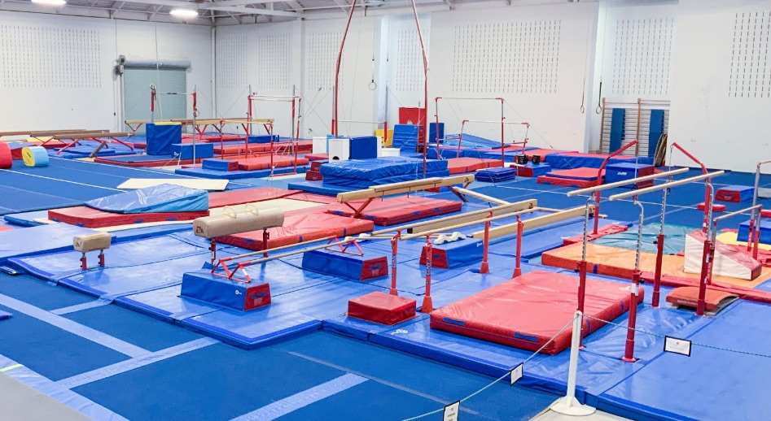
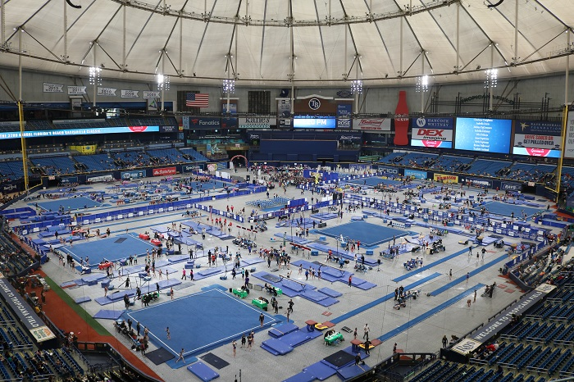
Determine
Facility/Venue
At your club?
Or at an outside facility?

Slide 9
Competition Venue
Floor Plan
Field of Play (FOP)
Equipment anomalies
Athlete corral (mandatory for Championships events)
Area for coaches
Area for spectators
Judges’ meeting area
Awards area (separate area mandatory for WAG/MAG Championships)
If you are hosting outside of your gym be sure to secure venue early!
Venue must be the appropriate size to host your number of athletes, coaches, judges and spectators
Must be the appropriate size for all equipment with plenty of space for athletes and coaches to move around
Parking
Registration and admissions area
Concessions area
Area for vendors
Washrooms for participants and spectators
Signage
Medical
Safety & Security

Slide 10
Budget
Revenue
  Registration
  Gate
  Sponsorship
  Vendors
  Concessions
  Program
  Advertising
  Draws/raffles
Expenses
  Facility
  Equipment
  Judges
  Awards
  Gifts
  Food

Slide 11
Gymnastics Ontario Sanctioning
BID TO HOST
Required for all events
Can be found on the GO website
Timeline
  Sent out in late spring
  Goal is to have calendar established at the end of the current season or summer before the season begins
Hosts will receive tentative confirmation
Your event is not to be communicated until FINAL confirmation is received and GO calendar is posted
Application is not considered complete until all forms, documents and payments are received
First come-first served basis when all documents are received (more factors for WAG)
Sanction fee for International events
Hosting agreement required for all non-invitational events

Slide 12

Event Directive
This is your invitation
Name of host club
Meet director’s info
Location of event
Date of event
Gymnast eligibility
Competitive requirements
Equipment brand and info
Warm up/competition format
Registration information/Deadlines
Refund policy
Health and Safety
Coaching Requirements
Awards information
Accommodation information
Admissions information
Vendors
Media
Tourist information
You prepare and submit to GO for approval and posting
Templates are available online

Slide 13

Registration Information
GO Meet
  Program manager will create with host and distribute
  Host clubs collect registration and all payments. GO does not collect any registration fees.
  GO will take care of registration in scoring system for MAG & WAG. Host is responsible with assistance from Program Manager in T&T, RG and ACRO.
  All registration is completed through the program’s scoring system.
    Exception – TG is completed through and excel form that is uploaded into the scoring system.
Invitational/WAG Qualifier
  Host responsibility to create and distribute
  Stay on track of your numbers
  Close when full
  Can use scoring system, excel or combination of both

Slide 14
Registration Form (if applicable)
Usually completed through scoring system
NAME OF COMPETITION
CONTACT INFORMATION
REGISTRATION FEES AND APPLICABLE LATE FEES
DEADLINES
REFUND INFORMATION
SPACE FOR CLUB CONTACT INFORMATION
COLUMN FOR GYMNASTS’ NAME, BIRTHDATE, GO NUMBER, CATEGORY
COLUMN FOR COACHES’ NAME, GO NUMBER AND CERTIFICATION LEVEL
COLUMN FOR AMOUNT PAID
COLUMN FOR MALE/FEMALE (TG)

Slide 15

Volunteers
These are the volunteers that assist with running the competition on the day of the event
Registration
Concessions
Admissions
Hosting (athletes, coaches and judges)
Team Marshals
Assistant Scorer
Event Scorers
Flashers
Runners
Timers
Equipment Set-Up Take Down Crew
Equipment Adjusters
Announcing
Awards
….and more!
The KEY to the success of your event!

Slide 16

Sponsorship
Establish Committee
Determine what kinds of sponsorship and donations you want/need
  $
  Donations
Sponsorship Package
  What are your saleable items?
  What can be given as donations/discounts?
  How can you acknowledge your sponsors?

Slide 17

Publicity, Advertising & Program
Establish Committee
Media
  Television
  Radio
  Newspaper
  Social Media
    Facebook
    Twitter
    Instagram
    Tik Tok
    And more!
Event Program?
  Potential for revenue generation
  Factors to consider
  Develop an example to bring to potential advertisers/sponsors
  Online? App?

Slide 18

Hosting & Hospitality
Hospitality
  Athletes
    Area/Corral
    Change rooms
  Coaches
    Area
    Food/Meals
  Judges
    Meeting room
    Meals
    Accommodations
  VIP
    Seating
    Meals
    Accommodations
Medical
  Area
  Food

Slide 19
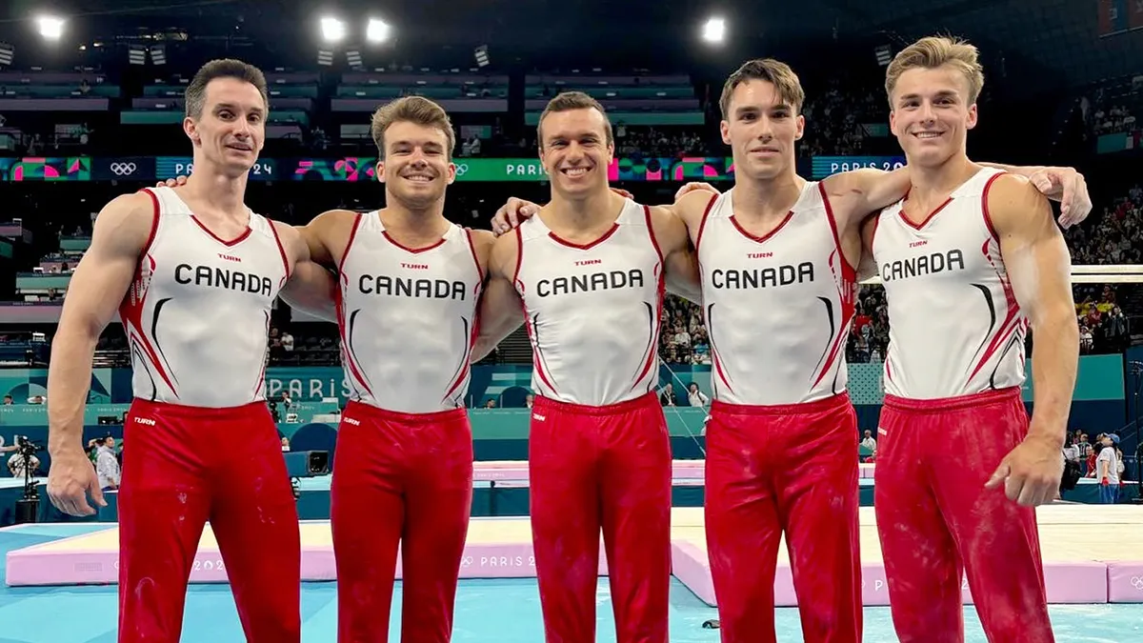
Hosting & Hospitality continued
Audio/Visual & Announcing
Ceremonies
  Opening (Oaths)
  Closing
  Awards

Slide 20

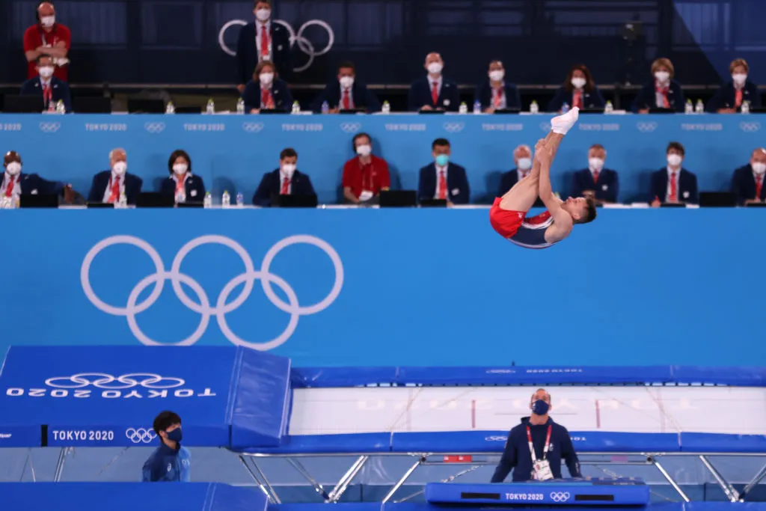
Judges
GO Meet
All judges are assigned by GO
WAG Qualifiers and Invitationals
CCJ is assigned by GO
Club is responsible for acquiring judges in consultation with CCJ
All Invitationals
Host club is responsible for obtaining judges
For all events, the host is responsible for expenses

Slide 21
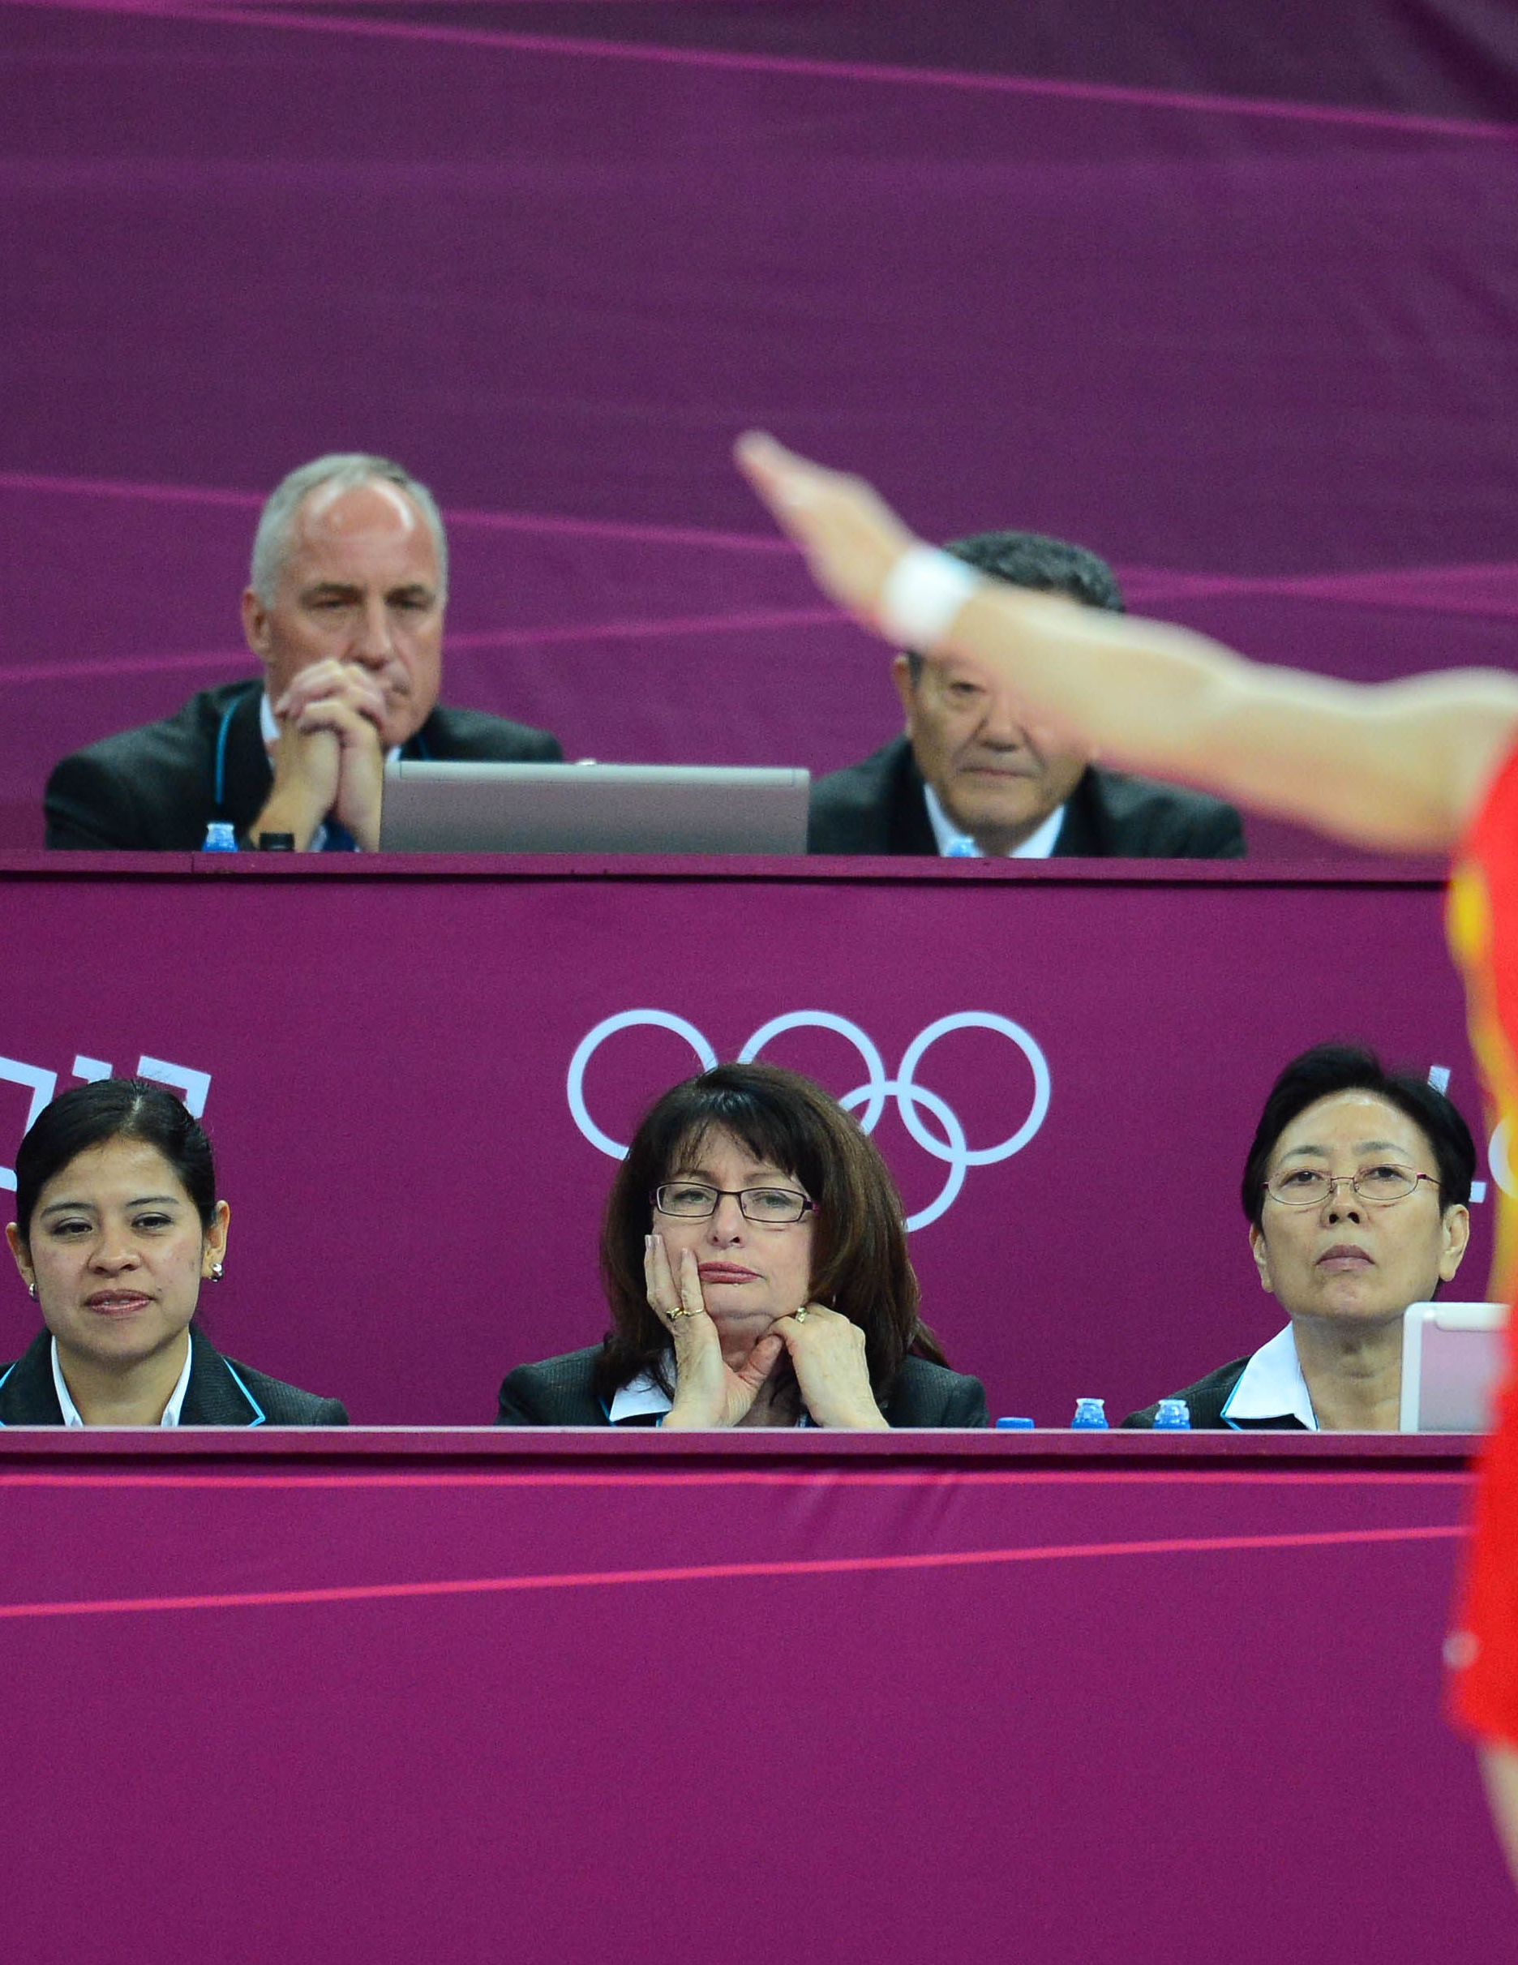
Judges continued
Package and Information
  Before: Event Directive, venue information, schedule and meeting times, accommodation info, list of judges, panels
  At Competition: updated schedule and athlete draw/start order, invitation to social events, honorarium form, report forms
Meeting Room
  Available minimum of 30 minutes prior to meeting start time and for 5 minutes after competition
  Must be able to comfortably accommodate the number of judges at your event
Expenses
  Mileage, honorarium, accommodations
  Know where your judges are coming from as they are expected to carpool whenever possible

Slide 22
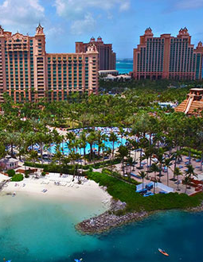
Accommodations
Determine your host hotel(s) and book rooms
  Group bookings
  Special rates
  You are responsible for the judges’ accommodations

Slide 23

Scheduling – GO Meet
  For all Qualifiers/Cups, Team Ontario/Tour Selection and Ontario Championships, the schedule will be created by the appropriate Program Manager and the Events Manager
  Host Clubs may request input
  Exception – WAG Qualifying Meets – HOST creates schedule and submits to Events Manager for approval
    Hosts may request assistance from the Events Manager

Slide 24

Scheduling - Invitational
VITAL TO THE SUCCESS OF YOUR MEET!
Invitational
  Your responsibility
  WAG has a very detailed formula!
  Communicate as soon as possible (minimum 4 weeks before)
  Competition Format & Warm-Up Option
  Registration Time
  March-In time
  Warm-Up Time
  Competition Time
  Debrief Time
  Awards Time
  Breaks for Judges

Slide 25

Athlete Draw/Start Order
GO Meet
  GO will do a random draw
  GO will distribute to participating clubs
Invitational
  Your responsibility
  Can be completely random
  Best to utilize a “random picker” online tool
  Often helpful to keep clubs together
  Your responsibility to distribute

Slide 26
Scoring
GO Meet
  TScore (TG)
  KSIS (ACRO, MAG, RG, WAG)
WAG Qualifying Competition
  KSIS must be utilised
  Host is responsible for set up and maintenance of the competition in KSIS
GO Meet
  Host creates event in scoring program
  GO manages up until the event
  Host monitors scoring during the event
Invitational
  Host is responsible
  Your choice in scoring program

Slide 27

Awards
Invitational
  Host is fully responsible for creating and obtaining all awards
  You may decide on what type of awards to give and how many but be sure to keep in line with technical rules and regulations
Host is responsible for the cost of the awards and any related costs.
GO Qualifying Events
  Host is responsible for ordering
  Host may choose to use own awards or awards from GO supplier
  Exception: TG Cups
Tour Selection/Elite Ontario/Ontario Championships
  Host must use the GO awards
  Gymnastics Ontario orders awards on behalf of host

Slide 28

Risk Management
More detailed information in the MD Manual
  Negligence
  Liability
  Due diligence
Medical
  First-Aid Certified
  Emergency Action Plan
  First Aid Kit

Slide 29
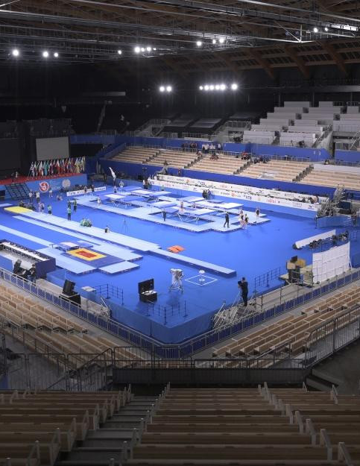
Competition Day
Prepare supplies ahead of time
Set up as much as you can the night before
Work with CCJ/Head Judge to assist in troubleshooting and to help the event run smoothly
Keep track of your schedule
Clean up and prepare for the next day

Slide 30

WRAP UP!
Distribute results if necessary
Send in any necessary reports
Pay invoices
Wrap up meeting with committee
Plan for next year!

Slide 31

Don’t forget that you can always contact your Program Manager or the Events Manager for assistance and questions

